Slide 1
Predictive Sensory Modeling: Use of Design of Experiments (DOE) and R to Optimize Dry Hop Mixtures for Aroma and Flavor Trent Leslie, Becca Ransohoff, Douglas Scott, Chandler Cottrell MadTree Brewing Cincinnati, OH

Slide 2
Agenda
Introduction to Design of Experiments (DOE, DOX)
Mixture Experiments
The Experiment
Experimental Design, Hardware, Data Collection
Data Format
Script Overview & Output
Putting It All Together
Q&A

Slide 3
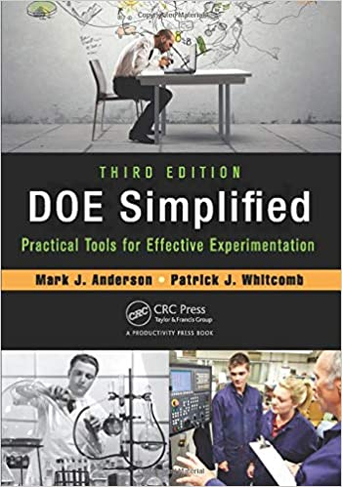
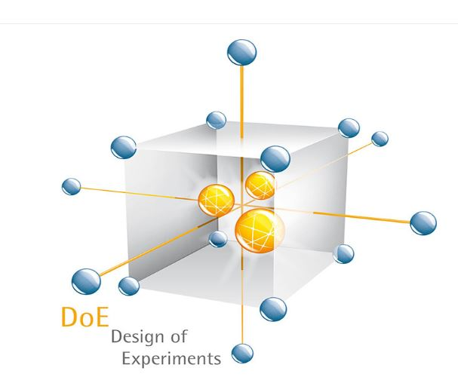
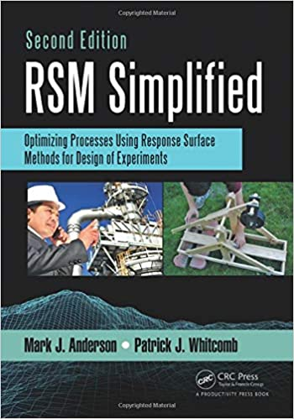
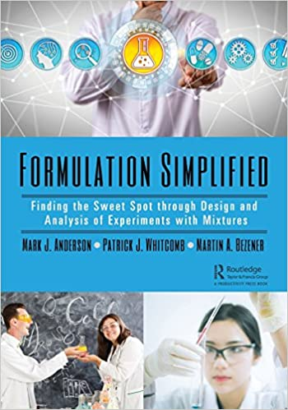
Design of experiments
Understanding complex systems (such as beer) by intentionally designing and executing experiments that help us investigate how variables in a system interact
Design experiments with terms that help you develop mathematical models to better understand relationships between variables

Slide 4
Comparison of approaches
One-Variable-at-a-Time Approach
Only look at a slice of an area of flavor space
Can’t see interaction effects
Minimum of two weeks in between tasting any test batches
Can’t compare changes in recipe or process between finished products
Inefficient – Can’t necessarily attribute changes in response to specific process or variable changes
DOE Approach
Learn about a selected “region” of the flavor space
See how all factors interact at once in the same base beer
Help minimize effects from natural variation in fermentation
Efficient – model all interactions at once, confirmation of model predicted optimum can be used for additional testing

Slide 5
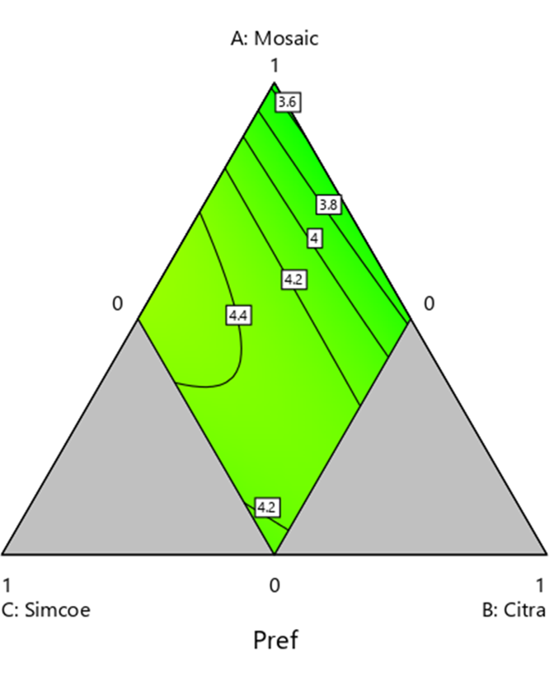
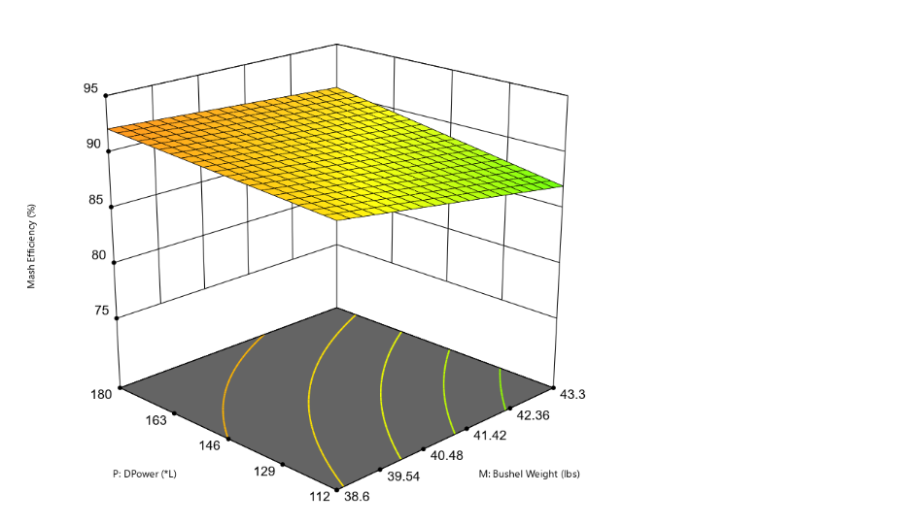
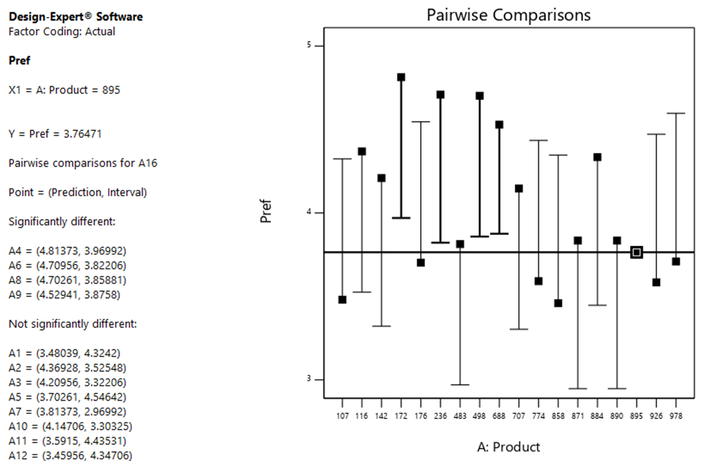
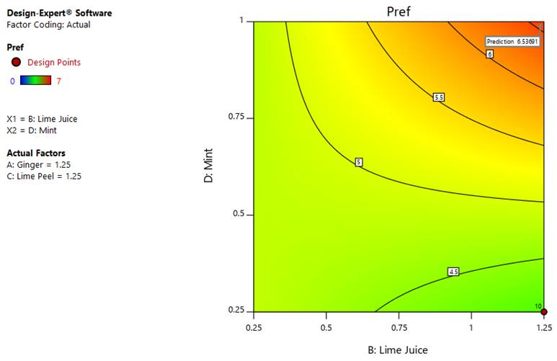
Types of experiments
What type to use depends on the type of data you are collecting and the questions you are asking
Simple comparison, factorial design, mixture experiment, response surface

Slide 6
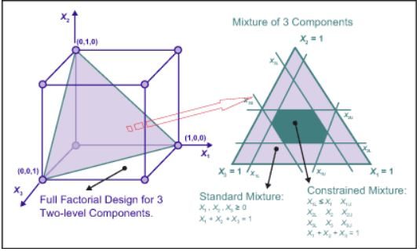
Mixture experiments
2-dimensional slice of a 3-dimensional factorial space
Factors are interdependent – the sum of all factors = 1

Slide 7
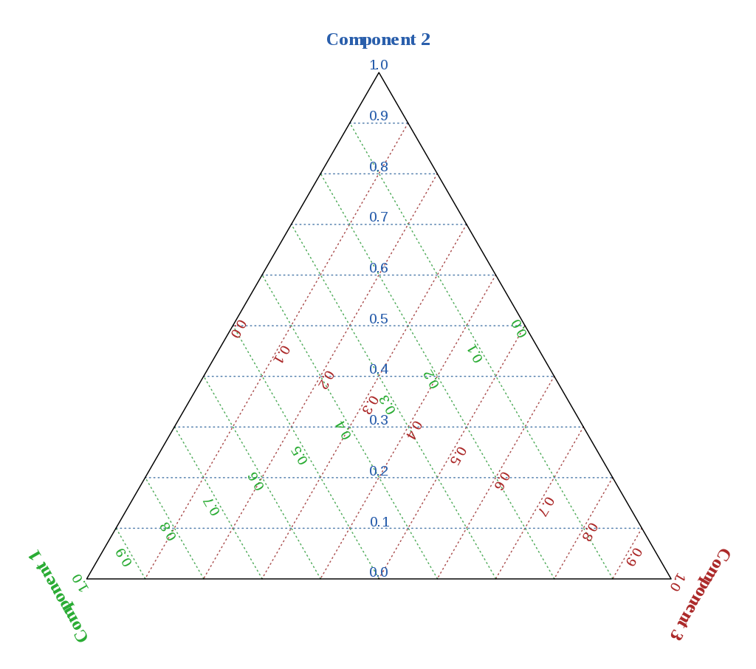
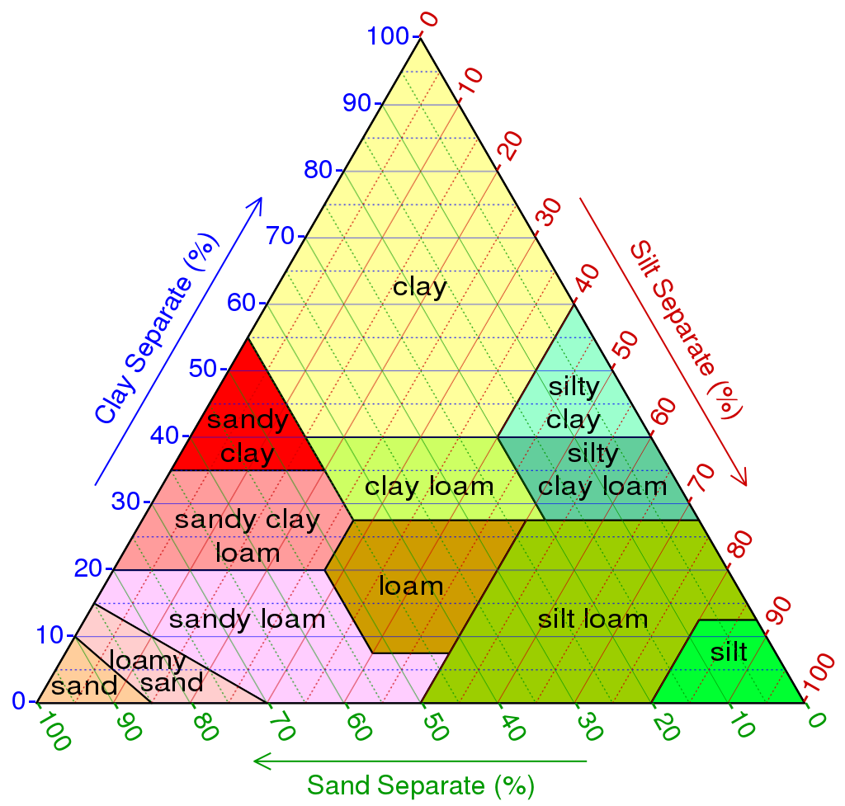
Mixture experiments – ternary plot

Slide 8
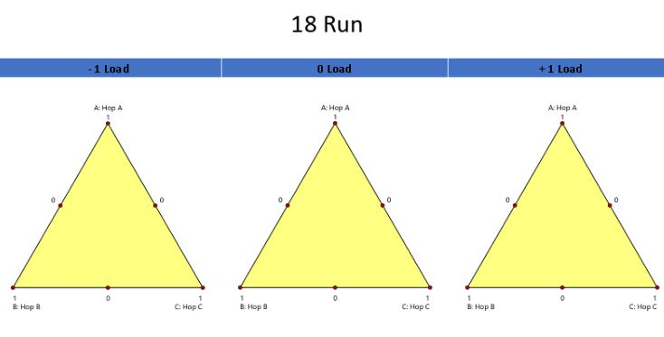
18 runs – full model
Run | A:Hop A | B:Hop B | C:Hop C | D:Hop Load
1 | 0.5 | 0 | 0.5 | -1
2 | 0.5 | 0.5 | 0 | 1
3 | 0 | 1 | 0 | -1
4 | 0 | 0 | 1 | 0
5 | 0.5 | 0.5 | 0 | -1
6 | 0 | 1 | 0 | 1
7 | 0.5 | 0 | 0.5 | 0
8 | 0.5 | 0 | 0.5 | 1
9 | 0 | 0 | 1 | 1
10 | 0 | 0 | 1 | -1
11 | 1 | 0 | 0 | 1
12 | 0 | 0.5 | 0.5 | 1
13 | 0 | 0.5 | 0.5 | -1
14 | 1 | 0 | 0 | 0
15 | 0.5 | 0.5 | 0 | 0
16 | 0 | 0.5 | 0.5 | 0
17 | 1 | 0 | 0 | -1
18 | 0 | 1 | 0 | 0
Model Terms: A, B, C, AB, AC, AD, BC, BD, CD, ABD, ACD, BCD, AD^2, BD^2, CD^2, ABD^2, ACD^2, BCD^2

Slide 9
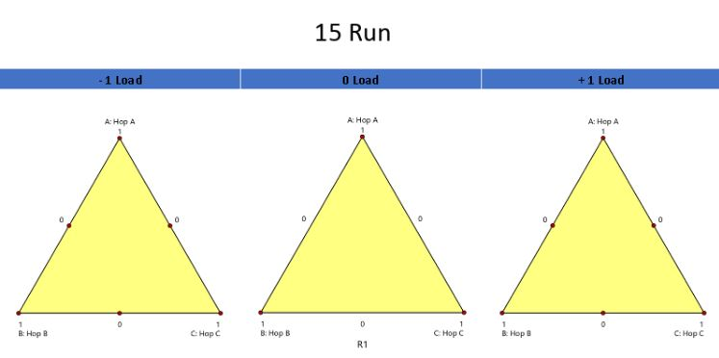
12 runs
Run | A:Hop A | B:Hop B | C:Hop C | D:Hop Load
1 | 0.5 | 0.5 | 0 | 1
2 | 1 | 0 | 0 | 0
3 | 0 | 0.5 | 0.5 | -1
4 | 0.5 | 0 | 0.5 | -1
5 | 0.5 | 0.5 | 0 | -1
6 | 0 | 0 | 1 | 0
7 | 0.5 | 0 | 0.5 | 0
8 | 0 | 0.5 | 0.5 | 1
9 | 0 | 0.5 | 0.5 | 0
10 | 0.5 | 0.5 | 0 | 0
11 | 0.5 | 0 | 0.5 | 1
12 | 0 | 1 | 0 | 0
Model Terms: A, B, C, AB, AC, AD, BC, BD, CD

Slide 10
9 runs
Run | A:Hop A | B:Hop B | C:Hop C | D:Hop Load
1 | 1 | 0 | 0 | 0
2 | 0 | 1 | 0 | 0
3 | 0.5 | 0.5 | 0 | -1
4 | 0.5 | 0 | 0.5 | 1
5 | 0.5 | 0.5 | 0 | 1
6 | 0 | 0.5 | 0.5 | 1
7 | 0.5 | 0 | 0.5 | -1
8 | 0 | 0.5 | 0.5 | -1
9 | 0 | 0 | 1 | 0
Model Terms: A, B, C, AB, AC, AD, BC, BD, CD

Slide 11
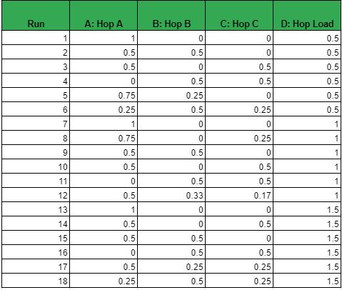
Our experiment
Goal – Finalize a dry-hop recipe for a new Double IPA recipe
Mixture experiment
Experimental Variables – 3 different hops
Hop A – 0-100%
Hop B and C – 0-50%
Experimental Ranges – Range of 0-1.5x dry hop rate (1.9 lbs/bbl)
Things we did not study – any hot side changes, limited to 3 hops, yeast strains

Slide 12
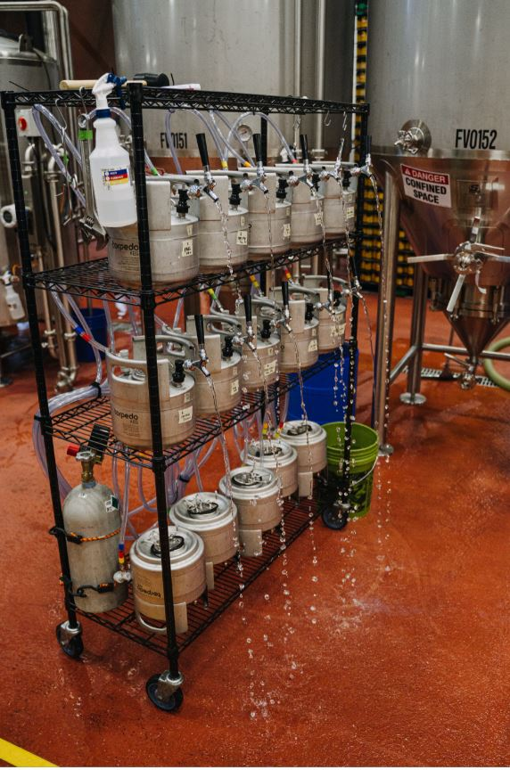
The Hardware
The following costs are associated with a 10-vessel collection system
Rack with Casters – $200
Stainless 1.5-gallon Kegs – $80 x 10 - $800
CO2 Manifold and Tubing – $200
Various fittings – $400
CO2 Tank – $50
Temperature Controlled Storage (chest freezer) - $800
Scale – $500
Total ~$3,000

Slide 13
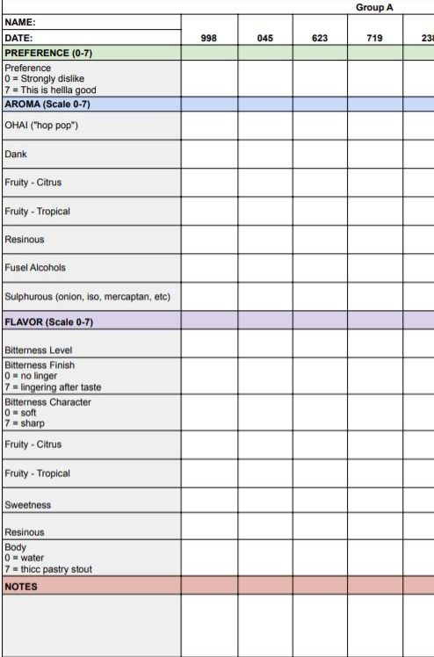
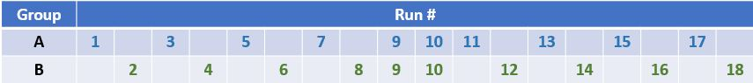
Sensory data collection
15 panelists – from trained research panel
Incomplete block – 2 groups each receiving 10 samples in one sitting
Scaling 7 aroma attributes, 8 taste attributes and overall preference
Collected over a one-week span

Slide 14
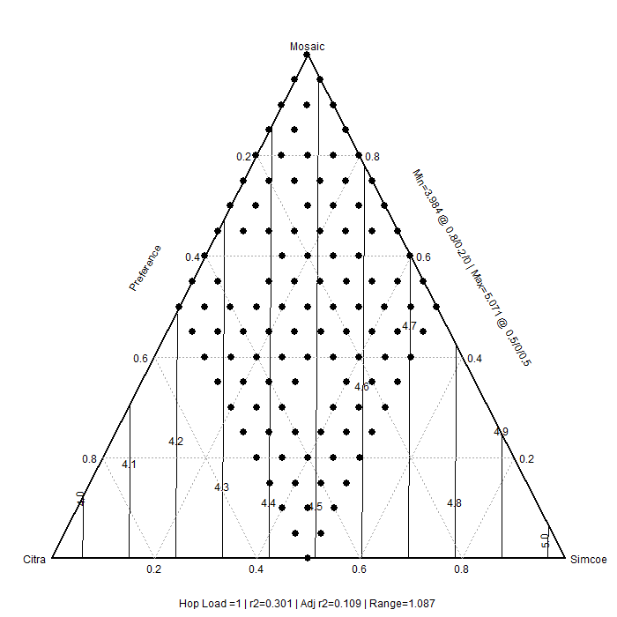
Analysis in R
Full analysis in R – a free and open source statistical programming language
Blocking of panelists
Development of contour plots
Optimization
In depth into the development of the script and its application can be seen in But Sometimes You Get What You Need: Using R to Optimize Dry Hop Mixtures for Aroma and Flavor

Slide 15
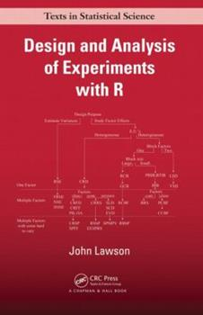
Background & Resources
2016 WBC Talk: Improving Brewhouse Efficiency by Adjusting Mash Thickness and Lauter and Sparge Volumes (Eddie Gutierrez and Drew Russey)
2017 ASBC Talk: Simplify QAQC Analyses and Decision Making with Open Source Software (Drew Russey)
2017 MBAA TQ: Improving Brewhouse Efficiency by Adjusting Mash Thickness and Lauter and Sparge Volumes (Eddie Gutierrez and Drew Russey)
2019 ASBC Workshop: From Bytes to BeeR: Leveraging the Statistical Programming Language R in Brewing Data Science (Drew Russey, Lucas Chadwick, Trent Leslie)
http://bit.ly/ASBCCodingWorkshop2019 (Video tutorials!)
2021 ASBC Talk: You Can’t Always Get What You Want - Use of Design of Experiments (DOE) to Optimize Dry Hop Mixtures for Aroma and Flavor (Becca Ransohoff, Chandler Cottrell, Trent Leslie, Doug Scott)

Slide 16
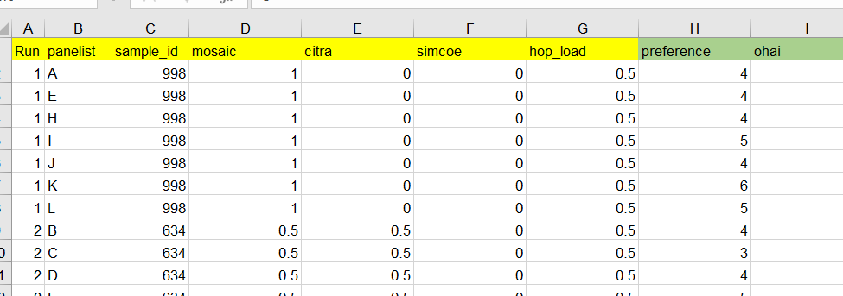
Input Data Format
Excel Spreadsheet (but that can be changed in the script)
First seven columns need to be there
However, the hop name columns can be changed to reflect whatever the experiment entails, but the script will need to be updated for that as well
Columns eight and on can be as many or as few as you want and can be anything

Slide 17
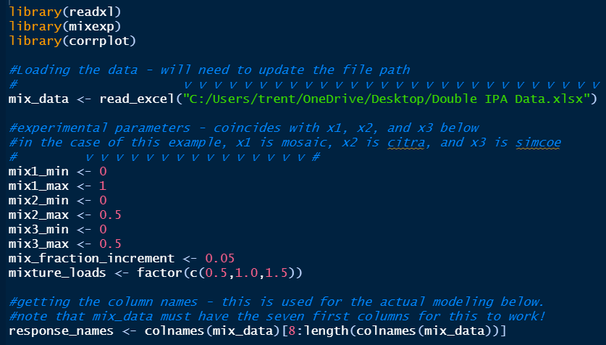
The script
Script and Powerpoint files are available on GitHub
https://github.com/trentleslie/ASBC_2021

Slide 18
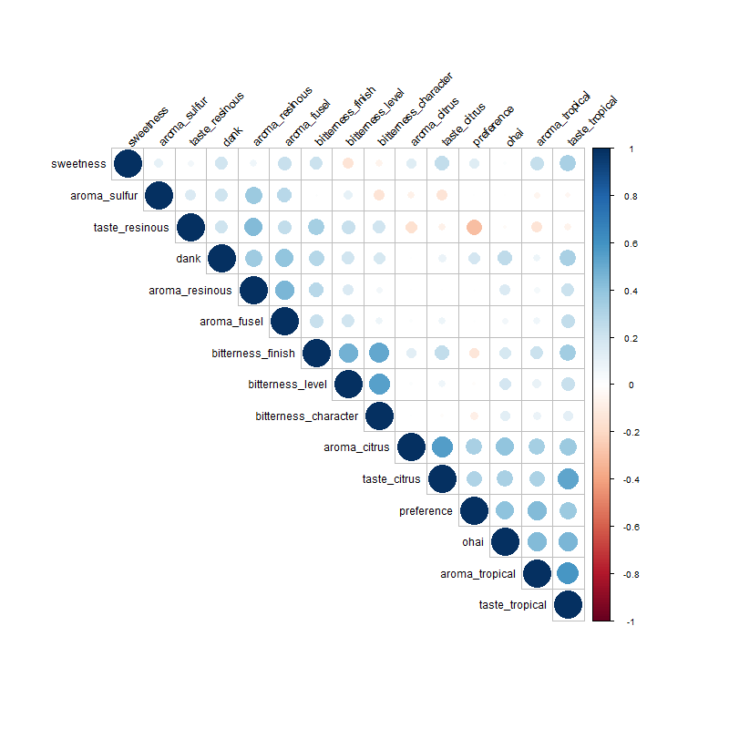
The output

Slide 19

Putting it all together
This brings us to the hard part: using your own judgement and conversations to determine what’s important and what’s most likely to lead to the best possible product.
Sensory is often messy, but design of experiments and this script may help provide guidance.

Slide 20
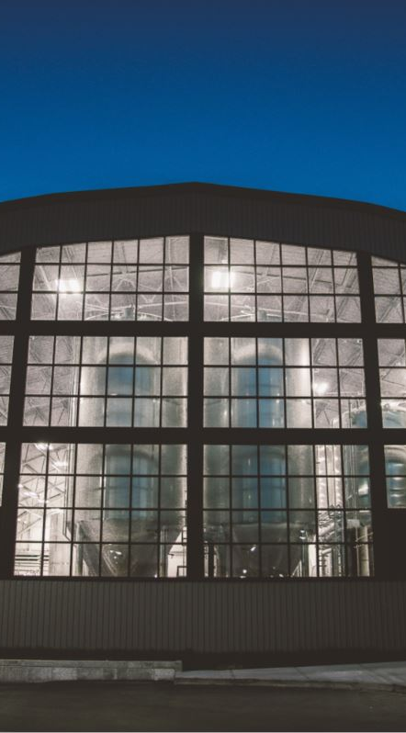

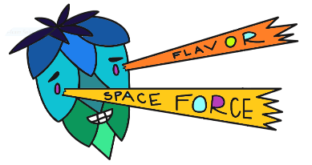

acknowledgements
Flavor Space Force Research Group
Becca Ransohoff
Doug Scott
Chandler Cottrell
Ryan Blevins
Garrett Schnieber

Slide 21
Questions?

